Slide 1



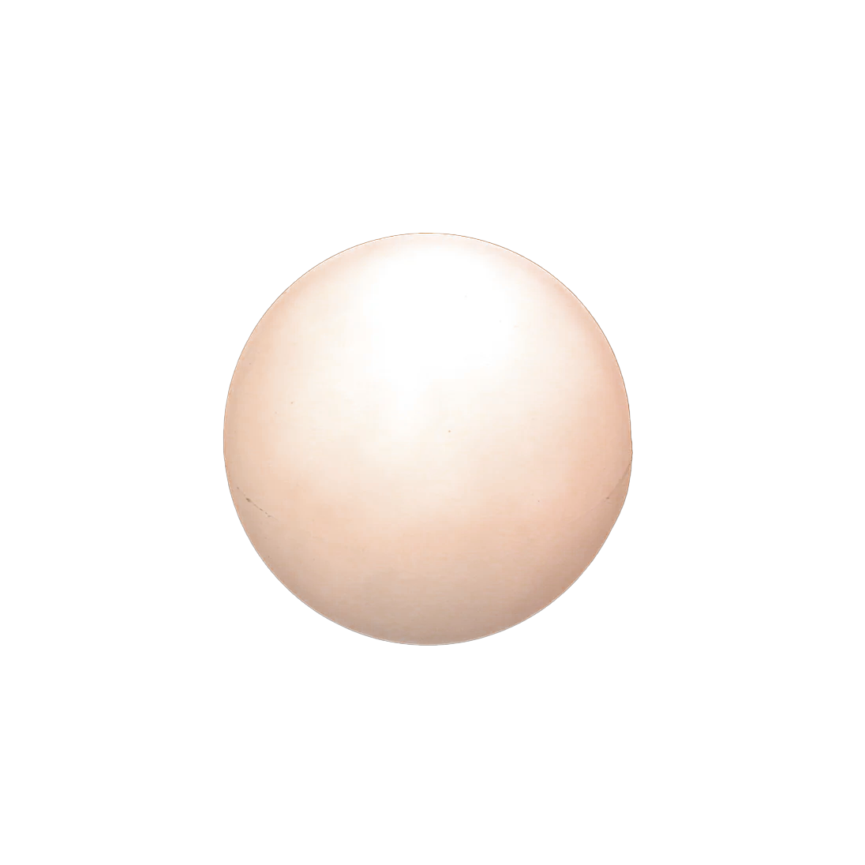
UNDERGRADUATE RESEARCH SYMPOSIUM EXHIBITION
SELALI OBOBI

Slide 2



MY PROJECT:
THE COLOR OF MEMORY
I aim to explore how photographic narratives can convey a space's " story " or its personal memories. I would like to research how the manipulation of color can invoke certain emotions within the audience's perception of narrative flow and understanding of an individual’s storytelling. The aim would be to understand the tools that illustrate history, memory, and personal significance to individuals in these curated environments.
Research Aim/Methodology:
I would interview different candidates and find out their favourite pseudo-public spaces that hold an air of sentimentality to them. Through the telling of their personal stories, the aim would be to photograph them and capture a candid photograph of them telling their story. To avoid restimulating negative emotion/memory, the memory would be of a happy, wistful, nostalgic, etc. essence. The aim would be to draw comparisons to ideas such as color in film or how gaming developers partake in world-building. After the changes are made to the images captured, I would recall the same interviewees and have them recount how the new image makes them feel and describe how the memory has shifted under the alterations.

Slide 3


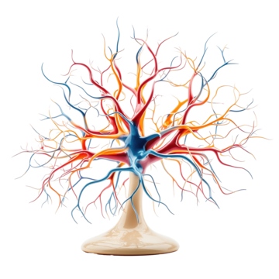



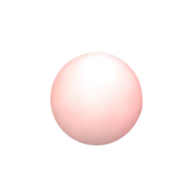

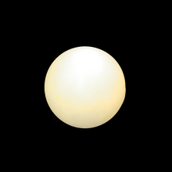
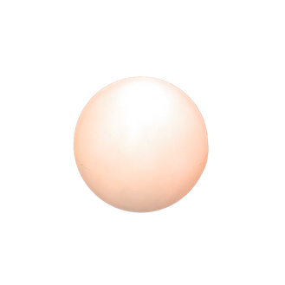



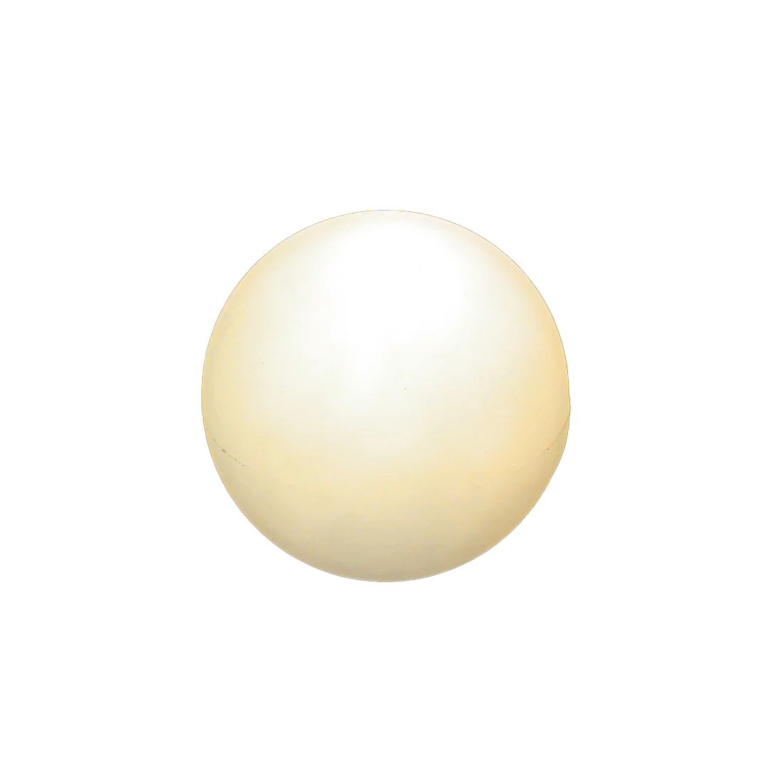
INTERIM EXHIBITION
This piece to my left is a trailer for the final exhibition. This poster aims to highlight the memory on the stem of the brain; showcasing the spawned memory result at the bottom.
In the portfolio file, the full posters are attached as static pngs, as well as the non-static video to better explain this exhibition.

Slide 4

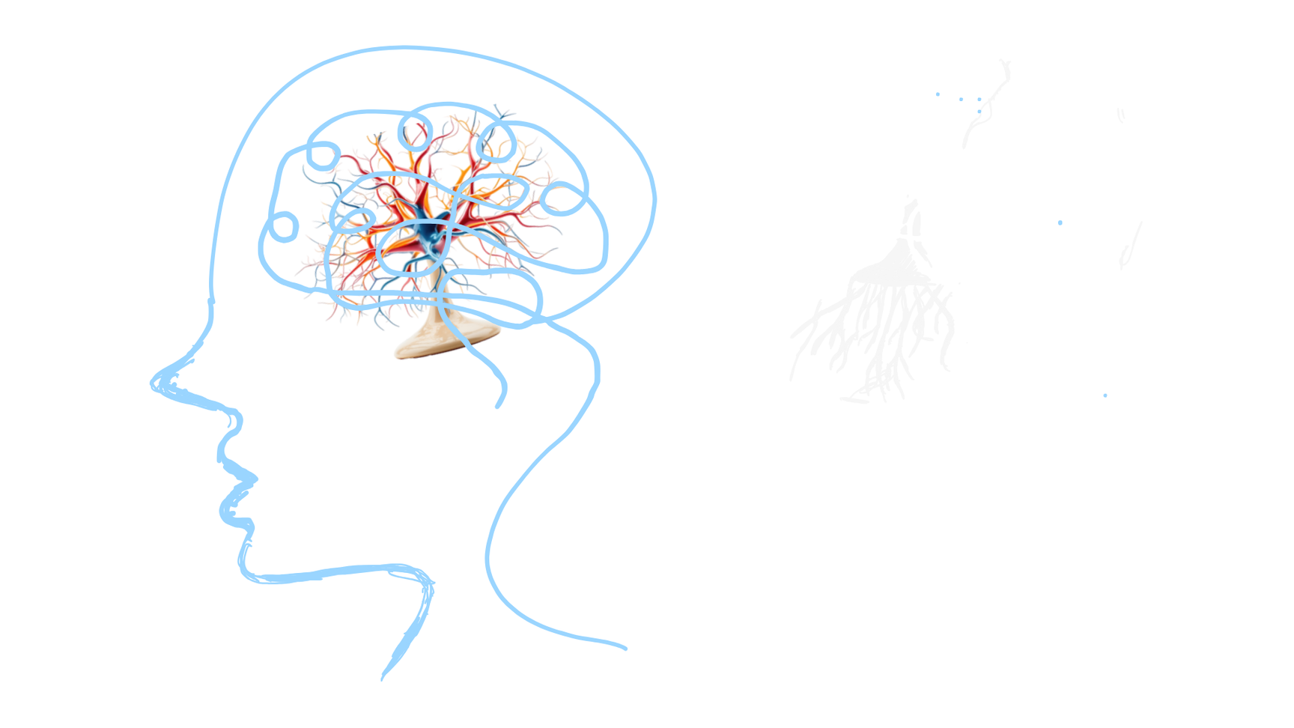


FINAL ANTICIPATED OUTCOME
The aim of the outcome for exhibition
would be to frame it like a person’s head with a brain. Ideally, it would be a 3D model instead of a 2D figure constructed out of papier mache. I would use cardboard/wire base to construct the base model and add papier mache to bring the model to life.
Ideally, the model would be hung from the ceiling and dangle from above. It would be large enough that people could walk through the exhibit and explore. From the corners of the model would be TV monitors that showcase the raw images transforming into the edited images, along with text that describes the image that is being viewed.
3D/2D Model of brain Model 2:

Slide 5
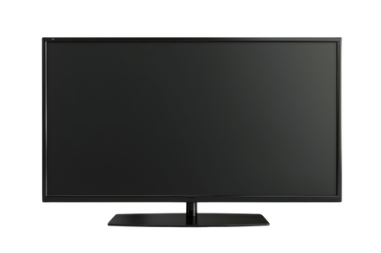

2D/3D MODEL:
MODEL 1
FINAL ANTICIPATED OUTCOME
This is my preferred outcome. But this is a model that would be made of either papier mache material and be a 3D model, or it would be a 2D paper model. The ideal frame of it would be papier machee, constructed from a wire/cardboard base. The shape would be a big neuro pathway with several memory bubbles popping from the sides. On top of the bubbles would be a bunch of TV monitors that showcase the transition from the raw image to the edited one. An attached message explaining what the memory is about, alongside the reaction to the edited image from post-production, is also included.
Ideally, the model would be hung from the ceiling as a 3D frame; however, if it becomes 2D, it can be attached to a wall. That way, it would be easier to access the monitors around the diagram.
Memory Bubble with tv screens on top

